Slide 1
ΤHz gas spectroscopy
Rotational transitions of polar molecules
Rich spectral fingerprints
High selectivity and high sensitivity
High discrimination at low pressure
due to narrow Doppler linewidth (~1MHz)
☞Multiple gas analysis
(2) Less scattering
λ_{ΤHz} >> particle diameter
☞Possible to analyze gas
mixed with aerosols
(fog, cloud, smoke, soot, etc)
Atmospheric pollution
Ref)http://www.nature.nps.gov/air/aqbasics/sources.cfm
Notes:
1
Recent growing awareness of atmospheric pollution has increased the importance of gas analysis. In many case, we need to measure mixed gas which contains multiple gas molecules and unnecessary aerosols, such as smoke, soot, fog, cloud, and so on. THz gas spectroscopy has some advantages over other spectroscopy. There are rich spectral fingerprints caused by rotational transitions of many polar molecules in THz region. Absorption lines caused by rotational transitions enable high selectivity and sensitivity. Furthermore, THz gas spectroscopy has high discrimination at low pressure because Doppler linewidth is much narrower than that in visible and infrared regions. THz gas spectroscopy is less affected by scattering because THz wavelength is much longer than a particle diameter. In this way, THz gas spectroscopy well suits gas analysis.

Slide 2
ΤHz spectral fingerprints
Target gas
Atmospheric gas molecule
To discriminate the target gas correctly, high resolution, high accuracy, and broadband spectrum are required!!
Volatile organic compound (VOC) gas
Notes:
2
The absorption spectrum of Atmospheric gas molecules and VOC gases is shown here. VOC is the general term of organic compounds that become gaseous in the air. VOCs are emitted from factories, and produce other primary air pollutants such as high ground-level ozone and small particulate matter. Therefore, the instrumental analysis of VOC gases is important for the pollution control. In our experiment, we measured acetonitrile gas. However, as shown, there are not only VOC gases but also a lot of other gases in the atmosphere. To discriminate the target gas correctly, high resolution, high accuracy, and broadband spectrum are required.

Slide 3
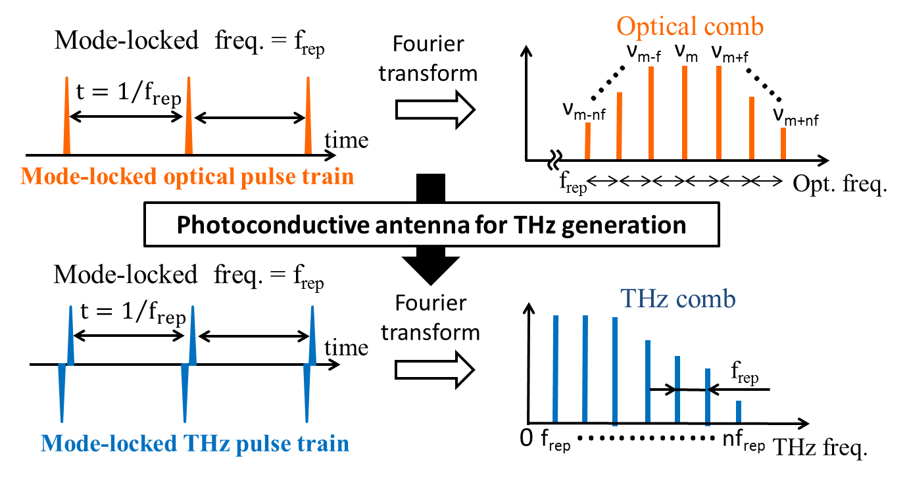
Optical comb & ΤHz comb
Time domain
Frequency domain
Simplicity, broadband selectivity, high spectral purity,
and absolute frequency calibration
Notes:
This slide shows behavior of optical comb and THz comb in time and frequency domains. Recently, optical frequency combs from a femtosecond laser can be used as a precise frequency ruler in optical region. When the optical pulse is incident on the PCA, the optical comb can be down-converted to the THz region without any change in its frequency spacing. The emitted THz comb is a harmonic frequency comb without any offset, which is composed of a fundamental component and a series of harmonic components of a mode-locked frequency of frep. Such a THz comb provides attractive features for gas spectroscopy. Attractive features are such as simplicity, broadband selectivity, offset free, and absolute frequency calibration. Therefore, THz comb can be used for THz gas spectroscopy that has high resolution, high accuracy, and broadband spectrum.

Slide 4
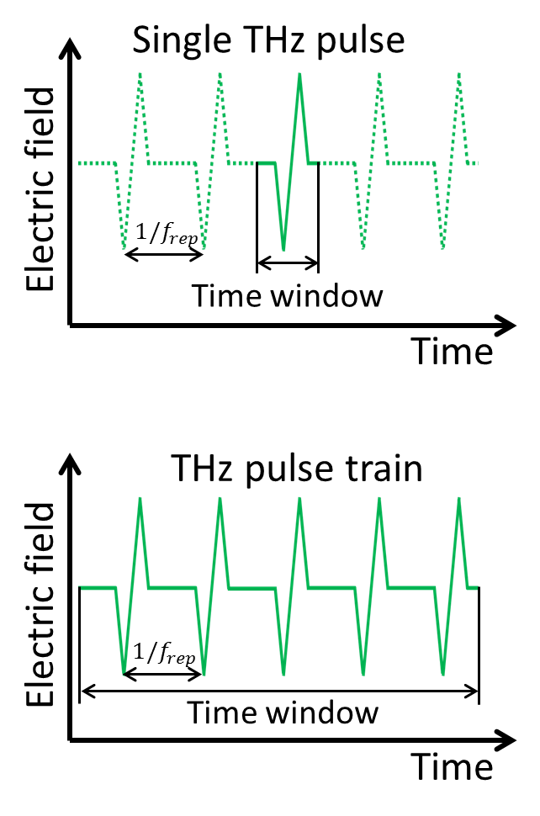
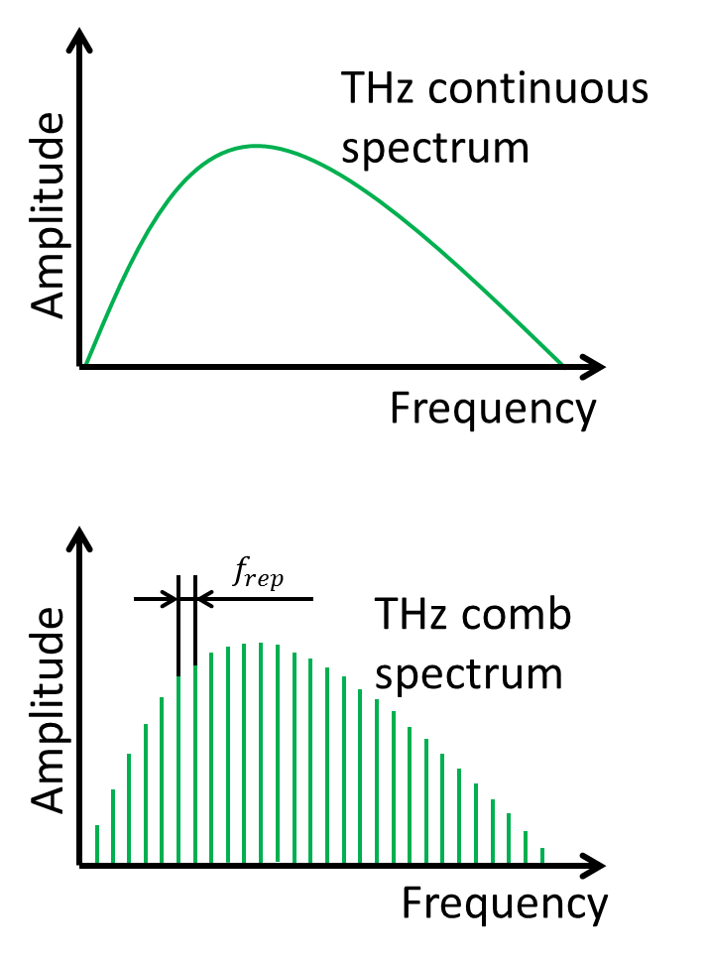
How to measure ΤHz comb
Traditional ΤHz-TDS equipped with mechanical time-delay scanning
F.T.
Time-window-extended ΤHz-TDS
F.T.
Notes:
This slide shows how to measure THz comb. In THz-TDS based on mechanical stage, we can acquire temporal waveform of only one THz pulse due to limitation on stroke. The spectrum obtained by Fourier Transform is a continuous spectrum, and does not have the structure of THz comb. On the other hand, we can obtain THz pulse train by expanding measurement time window larger than a pulse period. And frequency spectrum obtained by Fourier Transform has the structure of THz comb. In order to expand the time window, we used the asynchronous-optical-sampling method using dual fs lasers, namely ASOPS-THz-TDS.

Slide 5
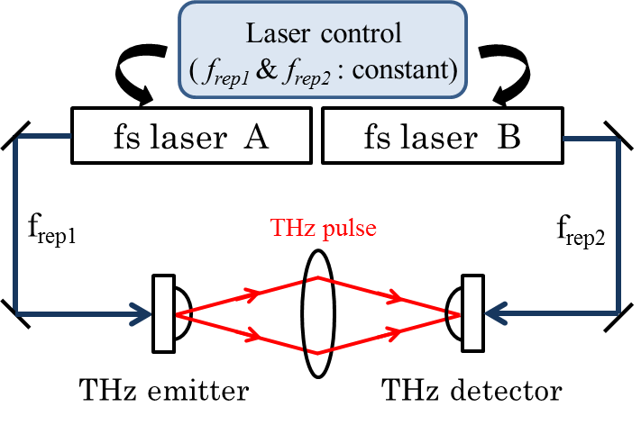
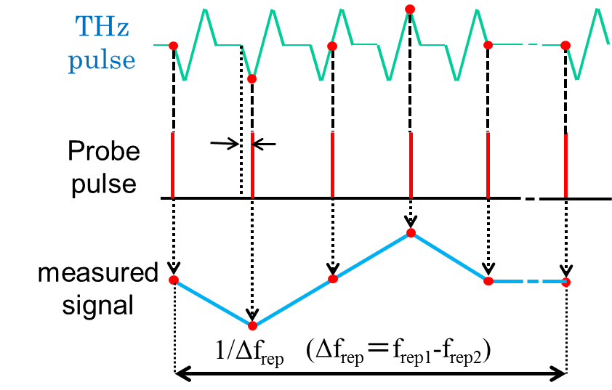
Asynchronous-optical-sampling ΤHz-TDS (ASOPS-ΤHz-TDS)
Overlap timing between ΤHz and probe pulses automatically shifts for each pulse
$$s=\frac{Δf_{rep}}{f_{rep1}f_{rep2}}$$
$${1/f}_{rep1}$$
Δf_{rep}＝ f_{rep1} - f_{rep2}
s
$$1/f_{rep2}$$
•No need for mechanical time-delay scanning
•No limitation on size of time window
Time scale of ps ΤHz pulse is linearly expanded to µs order
Temporal magnification factor (TMF) = $\frac{f_{rep1}}{Δfrep}$
ref) Appl. Phys. Lett. 87, 061101 (2005).
Notes:
In ASOPS, we use the dual femtosecond lasers that are controlled to have slightly different repetition rates. The pulse from the femtosecond laser A is incident on the PCA for THz generation, and THz pulse is emitted. After propagating in free space, THz pulse is incident on the PCA for THz detection. On the other hand, the pulse from femtosecond laser B, namely probe pulse, is incident on the PCA for THz detection. Then, the overlapping timing between THz and probe pulse is automatically shifts for each pulse due to the difference between repetition frequencies of the dual lasers. In this way, time scale of picosecond THz pulse expands to microsecond order. Period of acquired THz pulse is inverse of Δf_{rep}, and temporal magnification factor is here. This method enables us to measure THz pulses by an oscilloscope and eliminate the limitation on a time window. Generally, in this method, we use dual femtosecond lasers which repetition frequencies are stable enough. However, this has limited the practical application of ASOPS.

Slide 6
Use of free-running, dual fs lasers
in dual ΤHz comb spectroscopy
Expand the application fields of dual ΤHz comb spectroscopy
However, timing jitter between free-running dual fs lasers distort the linearity of time and frequency scales due to fluctuation of TMF!
Notes:
If we can use free-running dual femtosecond lasers in ASOPS, the application will be significantly expanded. However, the problem is that timing jitter between free-running dual lasers distorts the linearity of time and frequency scale due to fluctuation of temporal magnification factor.

Slide 7
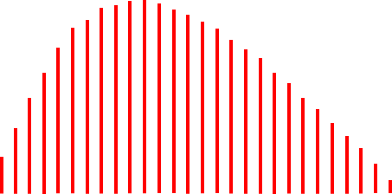
Influence of timing jitter in ASOPS
ΤHz region
RF region (ASOPS signal)
Frequency
downscaling
Electric field
Time
Electric field
$$×\frac{f_{rep1}}{Δfrep}$$
Time
Nonlinearity of time scale.
Time
Fluctuated!
F.T.
Frequency
Amplitude
$$×\frac{f_{rep1}}{Δfrep}$$
Amplitude
Frequency
[ΤHz]
Frequency
[MHz]
Frequency
calibration
Nonlinearity of frequency scale limits spectral resolution and accuracy!!
Nonlinearity of frequency scale.
Notes:
This is the flow-chart to get the THz comb spectrum in ASOPS. First, time scale of picosecond THz pulses is expanded to microsecond order based on temporal magnification factor. Second, we acquire the RF comb spectrum by Fourier Transform. Finally, we can obtain THz comb spectrum by frequency calibration. However, the linearity of time scale of the microsecond THz pulses is greatly distorted because the temporal magnification factor reflects the fluctuation of the lasers. And the same can be said about linearity of RF comb spectrum obtained by Fourier Transform. As a result, the accuracy and resolution of the THz comb spectrum obtained by rescaling reduce.

Slide 8
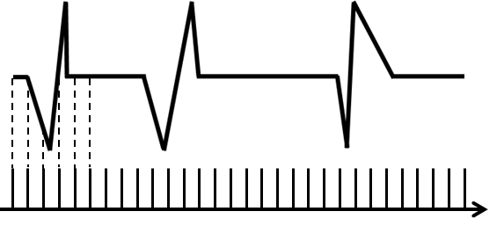
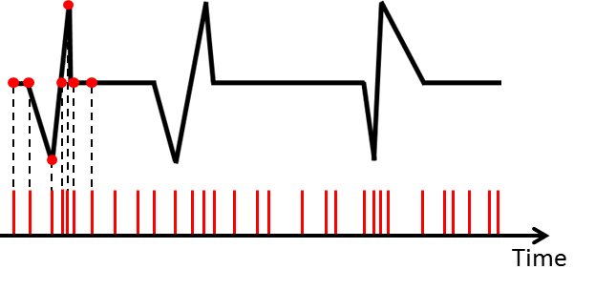
Adaptive sampling method
Ref) T. Ideguchi, Nat. Comm., 5, 3375 (2014).
Conventional method
(constant sampling)
Proposed method
(Adaptive sampling)
Sampled signal by ASOPS
Data acquisition
timing
Constant clock
Adaptive clock
reflecting timing jitter
Temporal waveform is still distorted!!
linearity of time scale
is recovered!!
Acquired
signal
Adaptive clock can be generated by beat signal between dual ΤHz combs!!
Notes:
So we developed adaptive sampling as a new method to solve this problem. Here is the THz pulse train obtained by ASOPS. The linearity of time scale is clearly distorted due to the influence of timing jitter. In conventional method, data acquisition timing of the THz pulse train is decided by the constant clock of the data acquisition board. However the acquired signal is still distorted. In a proposed method, we use the adaptive clock which reflects the fluctuation of timing jitter for data acquisition timing. As a result, linearity of time scale is recovered, and we can get the THz signal without influence of timing jitter shown as here. The adaptive clock can be generated by beat signals between dual THz combs.

Slide 9
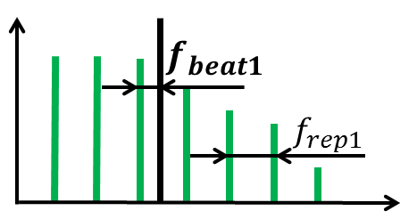
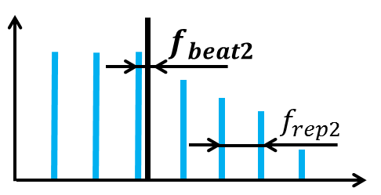
Beat signal between dual ΤHz combs for adaptive sampling clock
ref) Shuko Yokoyama et al.,Optics Express, Vol. 16, Issue 17, pp. 13052-13061 (2008)
PC -ΤHz comb 1
$$f_{beat1}$$
$$={f_{CW}−mf}_{rep1}$$
MHz
0
f_{rep1} - f_{beat1}
f_{rep1}
ΤHz
0
CW-ΤHz source for Local oscillator
$${mΔf}_{rep}$$
$${mf}_{rep1}$$
$$f_{CW}$$
LPF
PC -ΤHz comb 2
Beat signal between dual ΤHz combs
MHz
ΤHz
0
f_{rep2} - f_{beat2}
f_{rep2}
0
$$f_{beat2}$$
$$={f_{CW}−mf}_{rep2}$$
$${mf}_{rep2}$$
$$f_{CW}$$
Notes:
We extracted a beat signal between dual THz combs using dual THz spectrum analyzer as shown here. THz spectrum analyzer is based on a heterodyne technique with photoconductive mixing. The key difference between the electrical heterodyne technique and photoconductive mixing is the use of a photocarrier THz (PC-THz) comb as a local oscillator with multiple frequencies. The frequencies cover THz region. When two femtosecond laser lights are incident onto two independent photoconductive antennae (PCA1 and PCA2), two PC-THz combs with different frequency intervals of f_{rep1} and f_{rep2} are induced in PCA1 and PCA2 as shown in here. Then, when CW-THz wave is incident onto both PCA1 and PCA 2, two beat signals with f_{beat1} (= f_{THz} - mf_{rep1}) and f_{beat2} (= f_{THz} - mf_{rep2}) are generated as PCA current signals. m is the order of comb mode nearest in frequency to f_{THz}. Finally, we obtained the beat signal between two PC-THz comb (mf_{rep2} – mf_{rep1} = m∆f_{rep}) by electrically mixing these two beat signals and low-pass filtering. Please look at this formula.

Slide 10
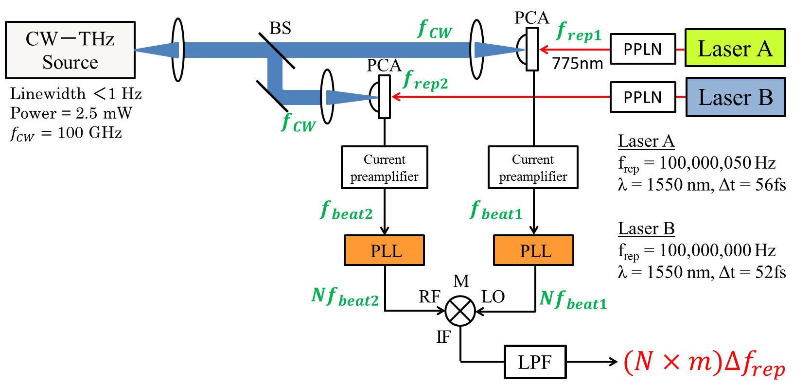
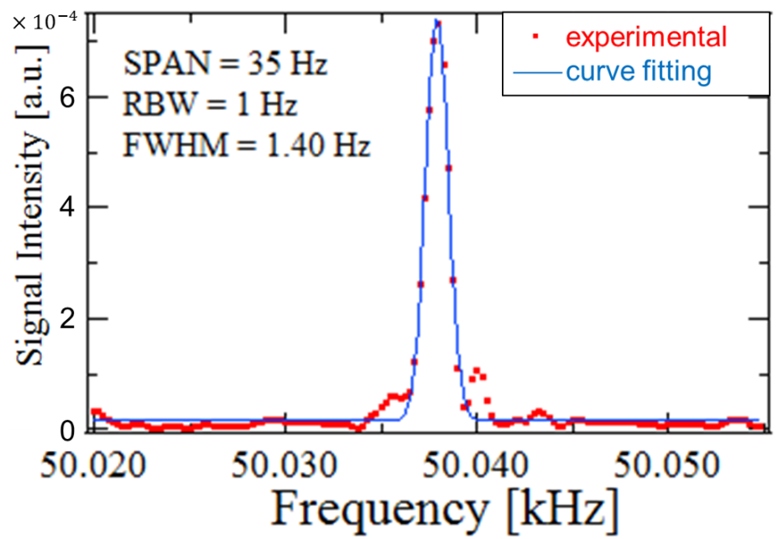
Experimental setup to extract the beat signal between dual ΤHz combs
Beat signal between dual ΤHz comb modes at 0.1 ΤHz
Notes:
This is the experimental setup to extract the beat signal between dual THz combs. Frep1 of free-running laser A is about 100MHz+50Hz, and frep2 of free-running laser B is about 100MHz. After wavelength conversion by SHG crystal, the two laser lights are incident onto the PCA, generating PC-THz combs in PCAs. Then, CW-THz wave is directed onto each PCA. The PC mixing between PC-THz comb and CW-THz wave generates beat signals. We acquire high order of beat signals between dual THz combs by the following three steps; first, amplify the beat signals with a current preamplifier. Second, multiply the frequency by N with PLL. Third, electrically mix each beat signals and low-pass filtering. This is the beat signal between dual THz combs at 0.1 THz.

Slide 11
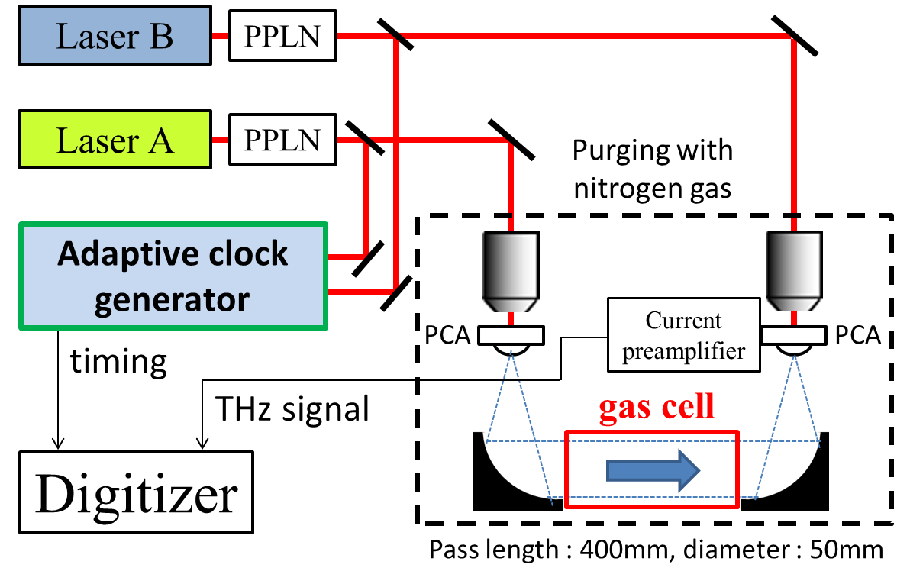
Setup for dual ΤHz combs spectroscopy
Notes:
This is the experimental setup for THz gas spectroscopy. THz pulse propagates the 400mm long and 50mm wide gas cell. In order to suppress the influence of water vapor in the atmosphere, the optical pass of the THz pulse has a nitrogen purge.

Slide 12
Integrated Temporal Waveform of 10 ΤHz pulses
Integration number : 10000
Signal disappeared!!
Constant clock
f_{rep1}& f_{rep2} free-running
Peak fluctuated!!
Constant clock
f_{rep1} & f_{rep2} stabilized
Peak constant!!
Adaptive clock
f_{rep1} & f_{rep2} free-running
Notes:
At first, we acquired the temporal waveform of 10 THz pulses. Green graph shows the result using a constant clock and free-running frep1 and frep2. THz signals disappear due to the influence of timing jitter. Blue graph shows the result of conventional method using a constant clock and stabilized frep1 and frep2. Red graph shows the result of the proposed method using adaptive clock and free-running frep1 and frep2. Though both of the red and green graphs use same free-running, THz signals obtained by proposed method can get the good THz signal without the influence of timing jitter. Furthermore, peak value is constant in proposed method, while the peak is fluctuated in the conventional method.

Slide 13
ΤHz comb spectrum
Constant clock
f_{rep1} & f_{rep2} stabilized
Adaptive clock
f_{rep1} & f_{rep2} free-running
Amplitude [a.u.]
noise floor
noise floor
Frequency [ΤHz]
Blurred comb mode!
Distinct comb mode!
f_{rep}
f_{rep}
Notes:
This is the spectrum obtained by Fourier Transform of 10 THz pulses. In both approaches, we obtained almost the same spectrum. However, at the expanded graph at 0.5 THz, the comb mode of the proposed method is clearly separated while that of the conventional method is blurred. This result shows that the influence of timing jitter remains in the conventional method.

Slide 14
Acetonitrile gas at low pressure(1kPa)
NASA database
Acetonitrile (CH₃CN)
・One of VOCs
・Very abundant species in
interstellar medium
18.4 GHz
Constant clock
f_{rep1} & f_{rep2} stabilized
Adaptive clock
f_{rep1} & f_{rep2} free-running
18.4 GHz
18.4 GHz
Frequency [ΤHz]
Notes:
Finally, we measure the acetonitrile gas which is a kind of VOCs. This is the absorption spectrum obtained by conventional and proposed method. These absorption lines caused by rotational transitions appear with interval of 18.4GHz, and in good agreement with the value calculated from rotational constant in both approach. However, at higher frequency, dynamic range of the proposed method is higher than that of the conventional method.

Slide 15
Summary
Dual ΤHz comb spectroscopy was attained using free-running dual fs lasers.
Spectroscopic performance: Adaptive sampling with free-running dual lasers $≧$Constant sampling with stabilized dual lasers
Possible to perform precision spectroscopy of low-pressure gas molecule using free-running dual fs lasers
Notes:
In summary, dual THz comb spectroscopy was attained using free-running dual femtosecond lasers. This experimental result is shown here.

